Slide 1
MATLAB Programming
Midterm Two
Instructor: 黃世強 (Sai-Keung Wong)

Slide 2
Content
There are four questions. You must answer all of them.
Each program must be interactive. Deduct 5pt if the program is too slow to run.

Slide 3
About demo video
A demo video may have bugs. The demo video shows roughly the results. These results may not be exactly the same as the requirements. They are for your own reference. You must follow the instruction to finish your programs.

Slide 4
Program file name format
Write all your programs in a folder. The folder name is mat_midterm02_student_ID. For example, if your ID is 12345678, the folder name is mat_midterm02_12345678.
Zip the folder and upload it.
Write a program for each problem in one file.
The file name is m02_X_yourStudentID.m, where X is the problem number.
For example, if your student ID is 12345678 and the problem number is 3, then the file name must be m02_3_12345678.m.
You must not output all the intermediate results.
Output the results that are required only.

Slide 5
File content header
At the top of the file, write down your name, ID, email address, department, and date.
%%%%%%%%%%%%%%%%%%%%%%%%%%%
% Midterm Number: …
% Problem number: …
% Student Name: …
% Student ID: …
% Email address: …
% Department:
% Date: ….
%%%%%%%%%%%%%%%%%%%%%%%%%%%%

Slide 6
File content
For each problem, display the problem number before showing the results.
close all; clear; clc; % close all windows
% clear variables, and clear screen
disp('Midterm Problem 2.1') % show Midterm Problem 2.1

Slide 7
(25%) Problem 2.1. Curve Filling
There are two curves which are plotted in the Cartesian and Polar coordinate systems, respectively.
Write a program to reproduce the animation result which must be similar to the example. The colors can be the different from the example.
Ask to input an option for the layout. 1) horizontal 2) vertical
Curve 1 (must be in the Cartesian coordinate system):
a = 2; b = 20; t = [0:0.02:6*pi];
x = (b-a) * sin(a*t) + b*sin( (a/b) * t)
y = (b-a) * cos(a*t) + b*cos( (a/b) * t)
At the beginning, the first curve is drawn for the first (S – 75) sample points, where S is the total number of the sample points.
Curve 2 (must be in the Polar coordinate system):
a = 7;
x = [-pi:0.2:-eps eps:0.2:pi];
r = a * sin( 2 * x ) / x;

Slide 8
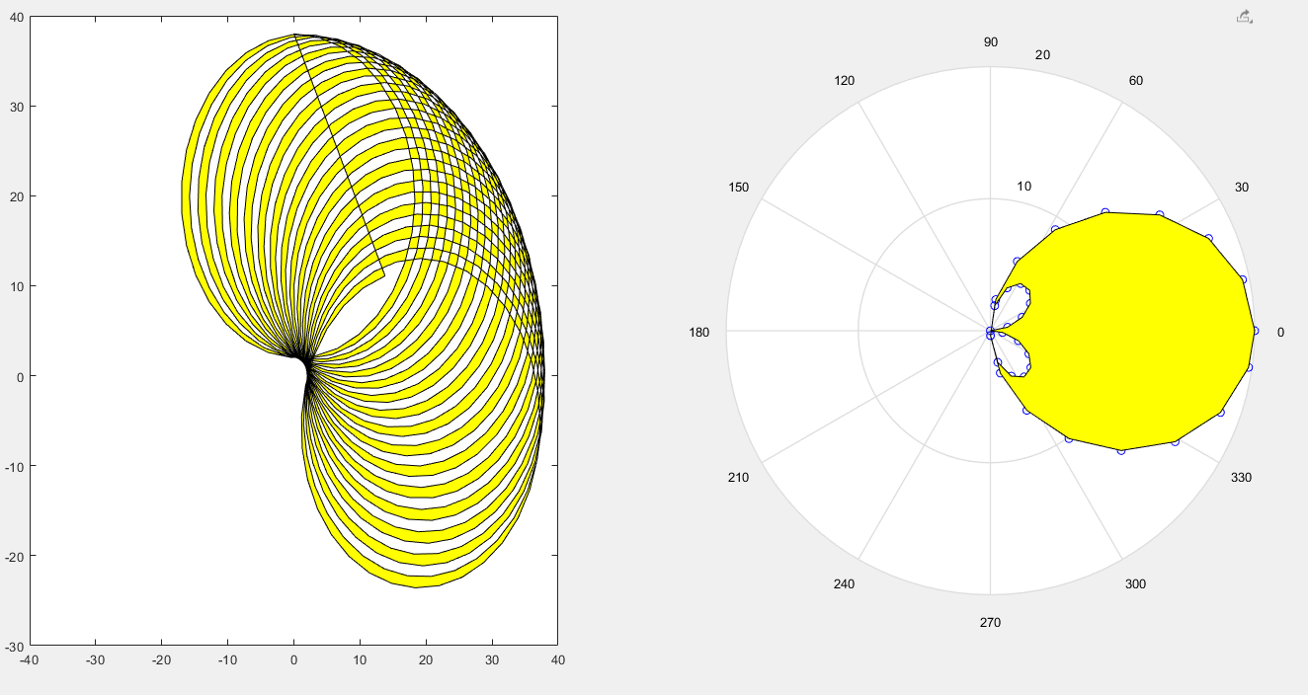
Curve 1
Horizontal layout
Curve 2

Slide 9
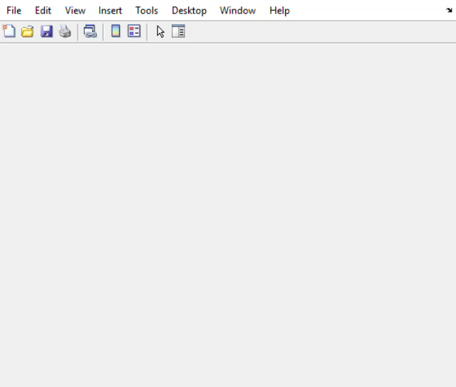
Curve 1
Horizontal layout
Curve 2
Play to see the animation.

Slide 10
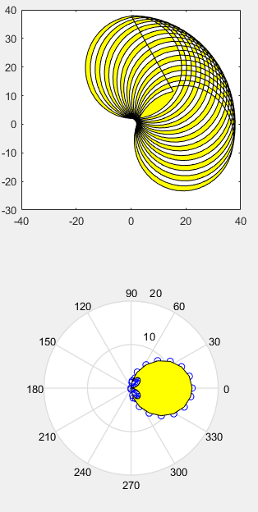
Problem 2.1 Marking scheme
[5%] The first curve is drawn in the Cartesian coordinate system.
[5%] The second curve is drawn in the Polar coordinate system.
[5%] The region is filled correctly for the first curve in an animation.
[5%] The region is filled correctly for the second curve in an animation.
[5%] The layout message must be shown for input. The layout option is handled correctly.
Example:
Select an option for layout
1) horizontal
2) Vertical
Vertical
Horizontal

Slide 11
(25%) Problem 2.2. Curve interpolation and extrapolation
Given two parametric functions: Function 1 (Butterfly) x1(t) = a1 * sin(t) * ( e ^{cos(t)} – 2 cos(4t) – sin⁵(t/12)); y1(t) = a1 * cos(t) * ( e ^{cos(t)} – 2 cos(4t) – sin⁵(t/12)); 0 <= t <= 12 π a1 = 3; t is the independent variable. | Function 2 (Hypotrochoid) x2(t) =(R-r) * cos(t) + d * cos(((R-r)/r)*t); y2(t) = (R-r) * sin(t) + d * sin(((R-r)/r)*t); R = 12; r = 4; d = R; 0 <= t < = 6 π r / (R-r)
Notice that the ranges of t for the two curves are not same. You must compute the correct step size of t so that the number of sample points are the same for both curves.
For function 1, you must use t = [0:0.1:12π].

Slide 12
(25%) Problem 2.2. Curve interpolation and extrapolation
Given two parametric functions: Function 1 (Butterfly) x1(t) = a1 * sin(t) * ( e ^{cos(t)} – 2 cos(4t) – sin⁵(t/12)); y1(t) = a1* cos(t) * ( e ^{cos(t)} – 2 cos(4t) – sin⁵(t/12)); 0 <= t <= 12 π a1 = 3; t is the independent variable. | Function 2 (Hypotrochoid) x2(t) =(R-r) cos(t) + d * cos(((R-r)/r)*t); y2(t) = (R-r) sin(t) + d * sin(((R-r)/r)*t); R = 12; r = 4; d = R; 0 <= t < = 6 π r / (R-r)
We can interpolate the two functions as follows:
x(t) = (1-k) x1(t) + k x2(t)
y(t) = (1-k) y1(t) + k y2(t)
k can be computed in two ways. Thus, we produce the animation process to interpolate the two functions in two plots. Let f = 0:0.1:1. The two ways are:
(Left) k = f*cos(2*pi*f), and (Right) k = (e^{f} -1)/(e-1). Apply the first way to the left plot and the second way to the right plot.
Ask to press ENTER before the animation is generated. The animation result must be similar to the example. There must be two plots (use subplots). Each plot shows one interpolation result. The animation must be smooth and interactive. Make sure that the figure window is on top.

Slide 13
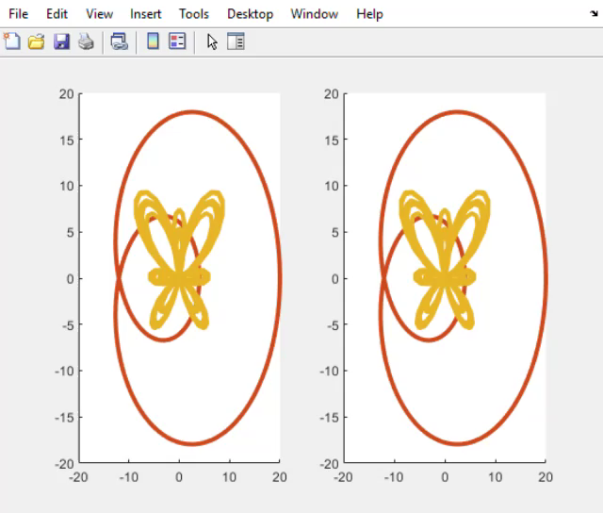
Problem 2.2
Play to see the animation.

Slide 14
Problem 2.2 Marking scheme
[8%] The interpolation is correct in the first plot.
[6%] The interpolation is correct in the second plot.
[6%] The animation is smooth and interactive.
[5%] The curves are correct and the colors of the curves are appropriate.

Slide 15
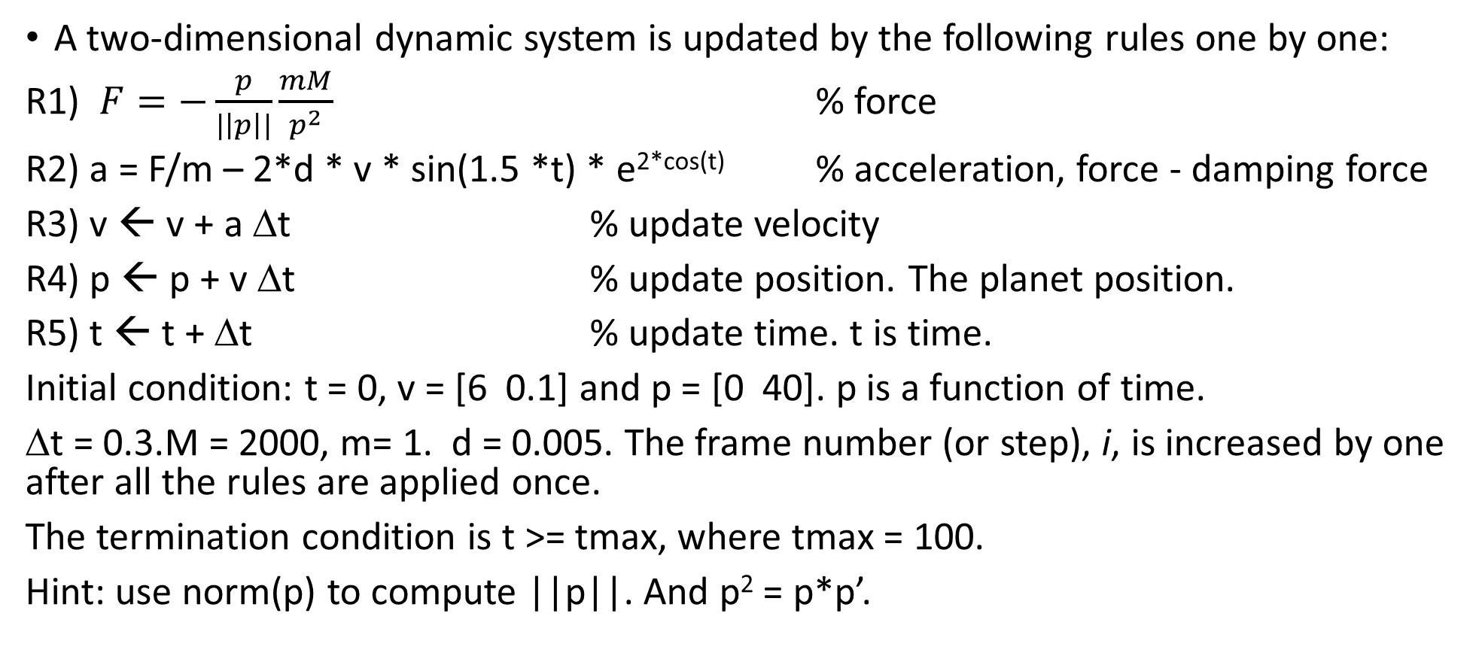
(25%) Problem 2.3. Planet trajectory and travel length
A two-dimensional dynamic system is updated by the following rules one by one:
R1) $F=−\frac{p}{|\left|p\right||}\frac{mM}{p^{2}}$ % force
R2) a = F/m – 2*d * v * sin(1.5 *t) * e^{2*cos(t)} % acceleration, force - damping force
R3) v ← v + a Δt % update velocity
R4) p ← p + v Δt % update position. The planet position.
R5) t ← t + Δt % update time. t is time.
Initial condition: t = 0, v = [6 0.1] and p = [0 40]. p is a function of time.
Δt = 0.3.M = 2000, m= 1. d = 0.005. The frame number (or step), i, is increased by one after all the rules are applied once.
The termination condition is t >= tmax, where tmax = 100.
Hint: use norm(p) to compute ||p||. And p² = p*p’.

Slide 16
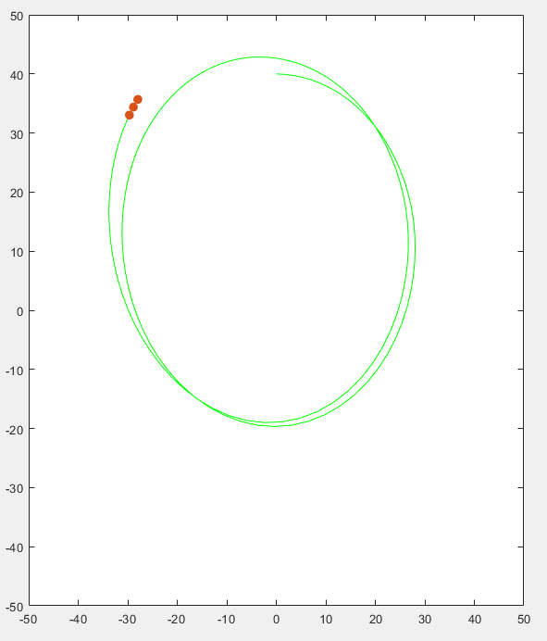
Problem 2.3
Draw the trajectory of the planet. The planet must be rotating around the origin (0,0) at the beginning.
Draw N recent sample points of the trajectory of the planet. The N points must be drawn clearly. Use markers to draw the points. Set the marker size as 25.
Here, N is 3.

Slide 17
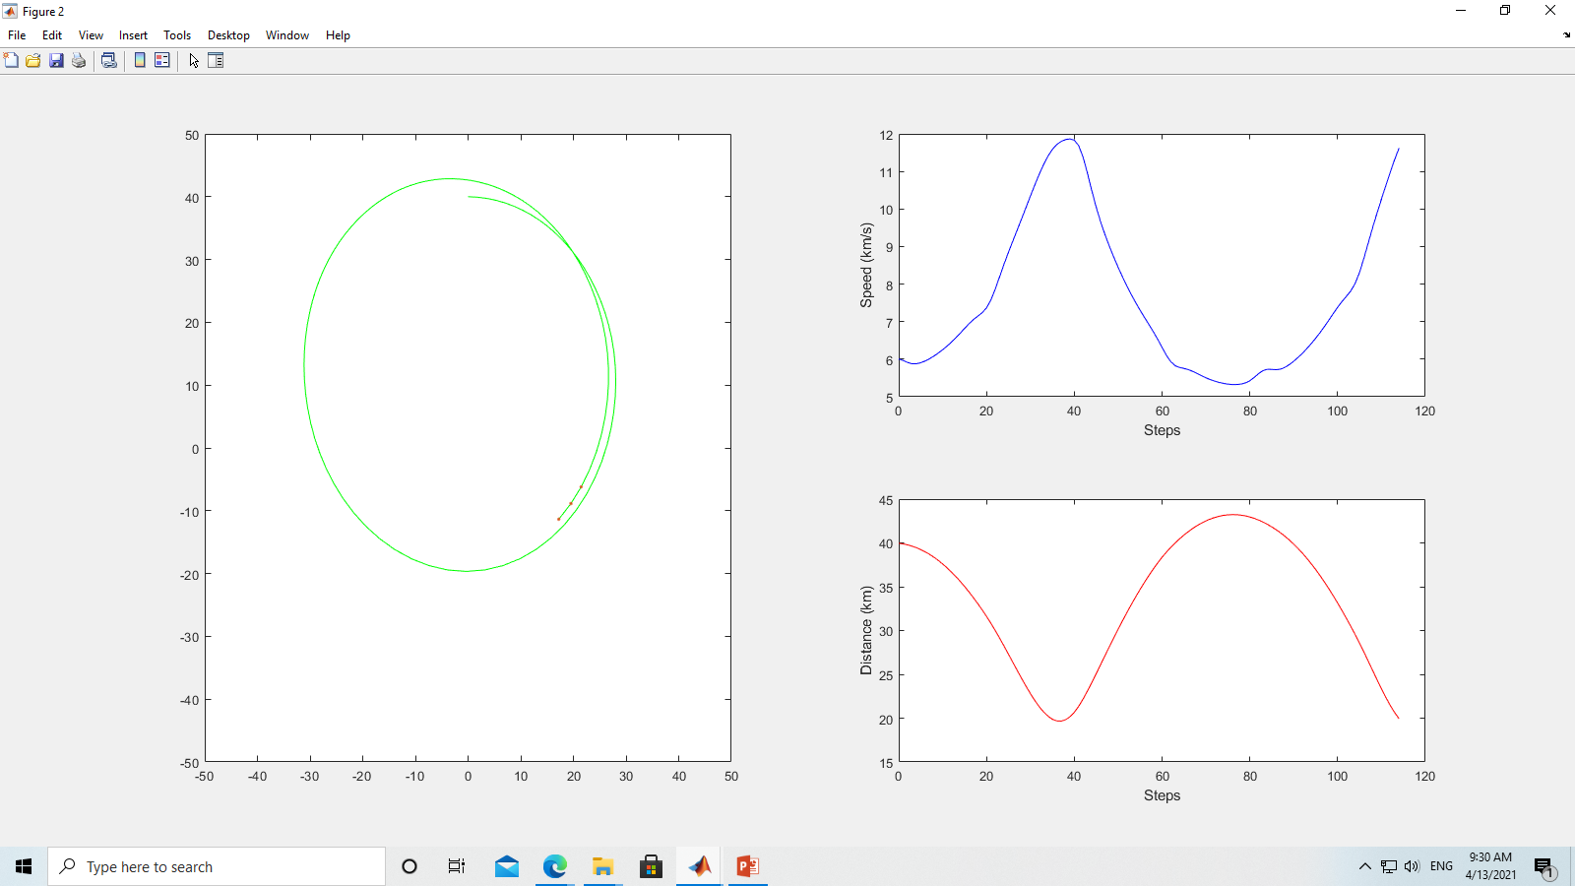
Problem 2.3
Draw the speed curve of the planet. Label the x- and y-axis properly.
Draw the distance curve of the planet. Label the x- and y-axis properly. The curve is blue.
The distance is between the planet and the sun. The sun is at position (0,0). The curve is red.

Slide 18
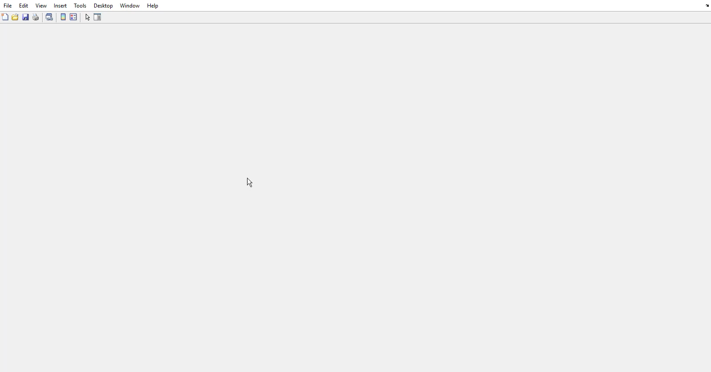
Problem 2.3
Play to see the animation.

Slide 19
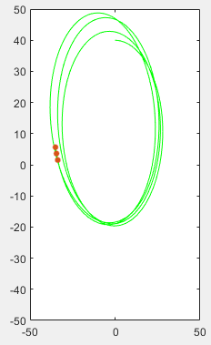
(25%) Problem 2.3 Marking scheme
Layout
[5%] The trajectory of the planet is similar to the example.
[3%] The most recent three points are shown clearly.
[3+1+1%] The speed curve is correct. Its color is blue. The labels are correct.
[3+1+1%] The distance curve is correct. Its color is red. The labels are correct.
[3+2+2%] The performance of the program must be interactive for the trajectory, speed, and distance curves.
Deduce 5 points if the layout is incorrect.

Slide 20
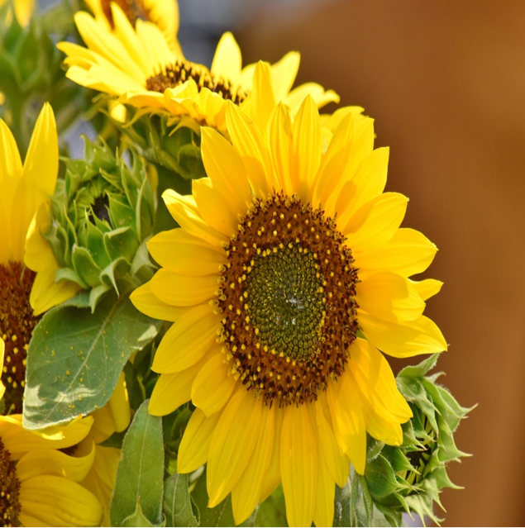
(25%) Problem 2.4. Image processing
Load a sunflower image as L1. Produce image L2 by resizing L1 to 640x640.
Use the Mexican Hat function to create a dynamic set of rings in a gray scale image (or intensity image) L3.
Modify the intensity of L3 by using a periodic function (e.g., a sine function or a cosine function). So that its intensity is changing in a cycle.
Rotate the center of the rings in clockwise direction about the center of L2. So that a new image, L4, is produced.
Use a linear function to modify the intensity of L4 to obtain image L5. Finally, show L5.
Repeat steps 2, 3, 4, and 5 to create an animation similar to the example. During the process, more and more rings are created.
Hint for generating the rings using the Mexican hat function.
f is the animation frame index
f0 = bf = f/numFrames;
f0 = bf*bf*pi*2;
r = sqrt(x.^2 + y.^2) + eps;
z = abs(sin(r.*f0) ./(r.*f0+eps));

Slide 21
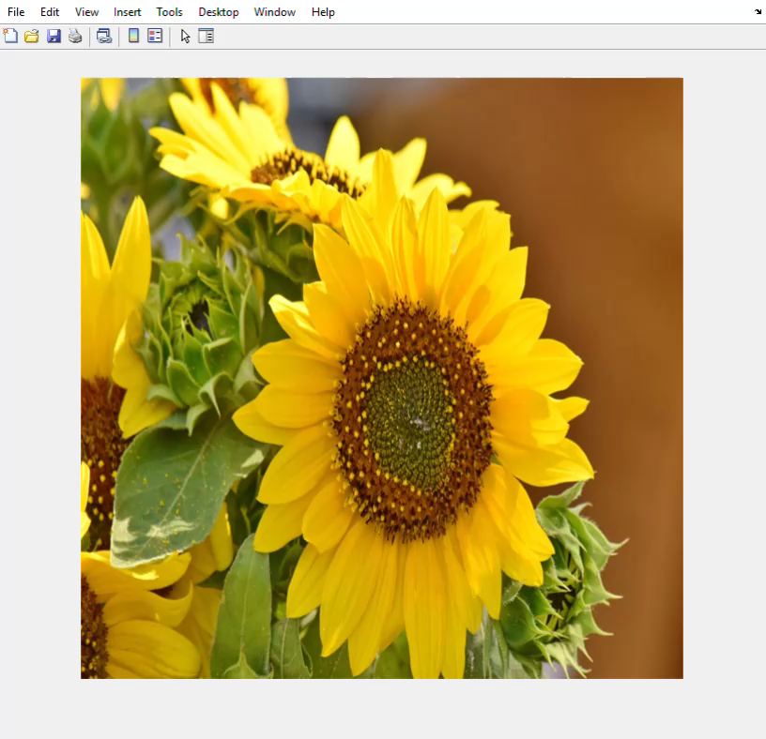
Problem 2.4. Image processing
Produce an animation
similar to the right example.
Play the example video to see the animation.

Slide 22
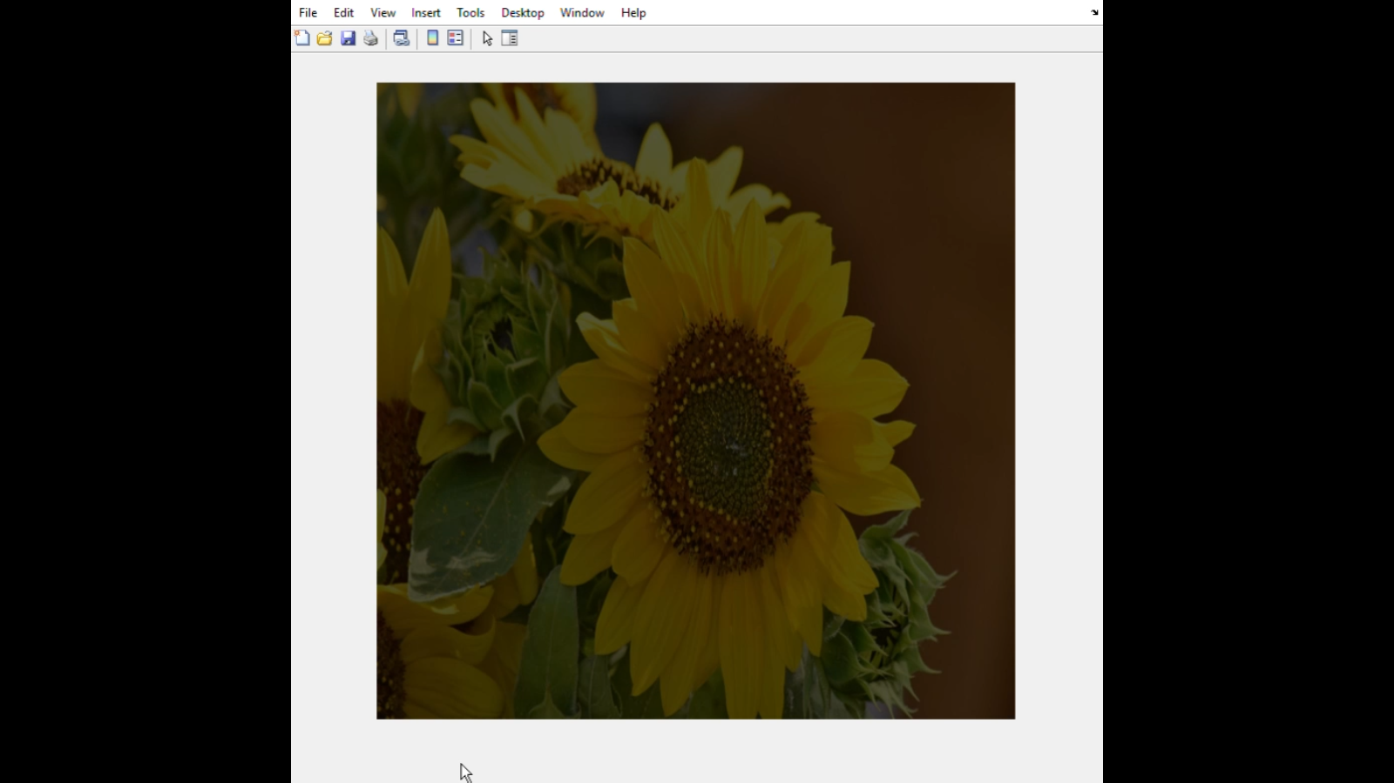
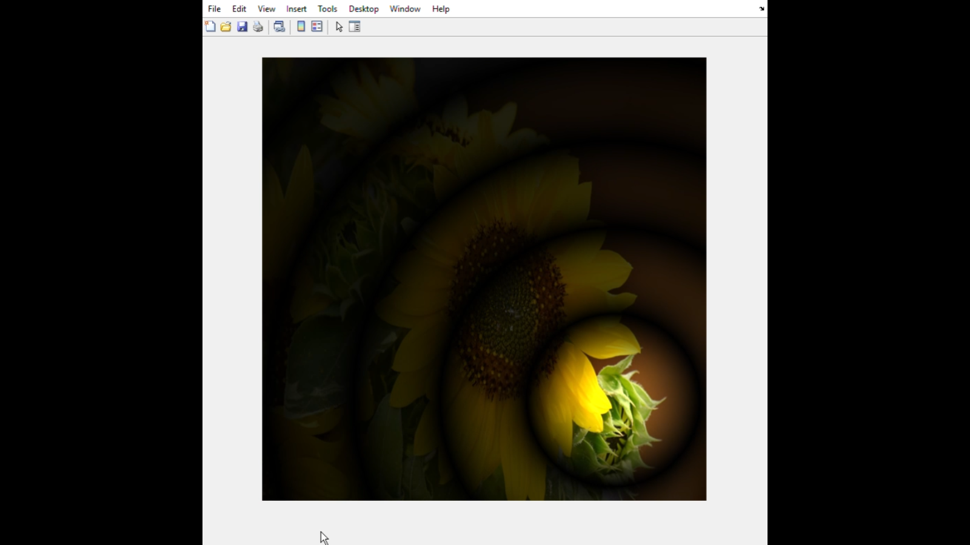
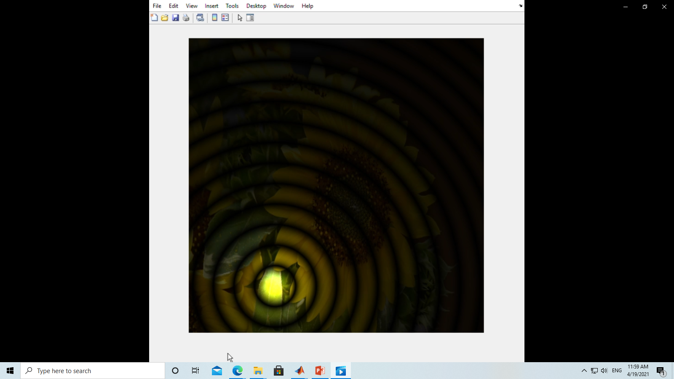
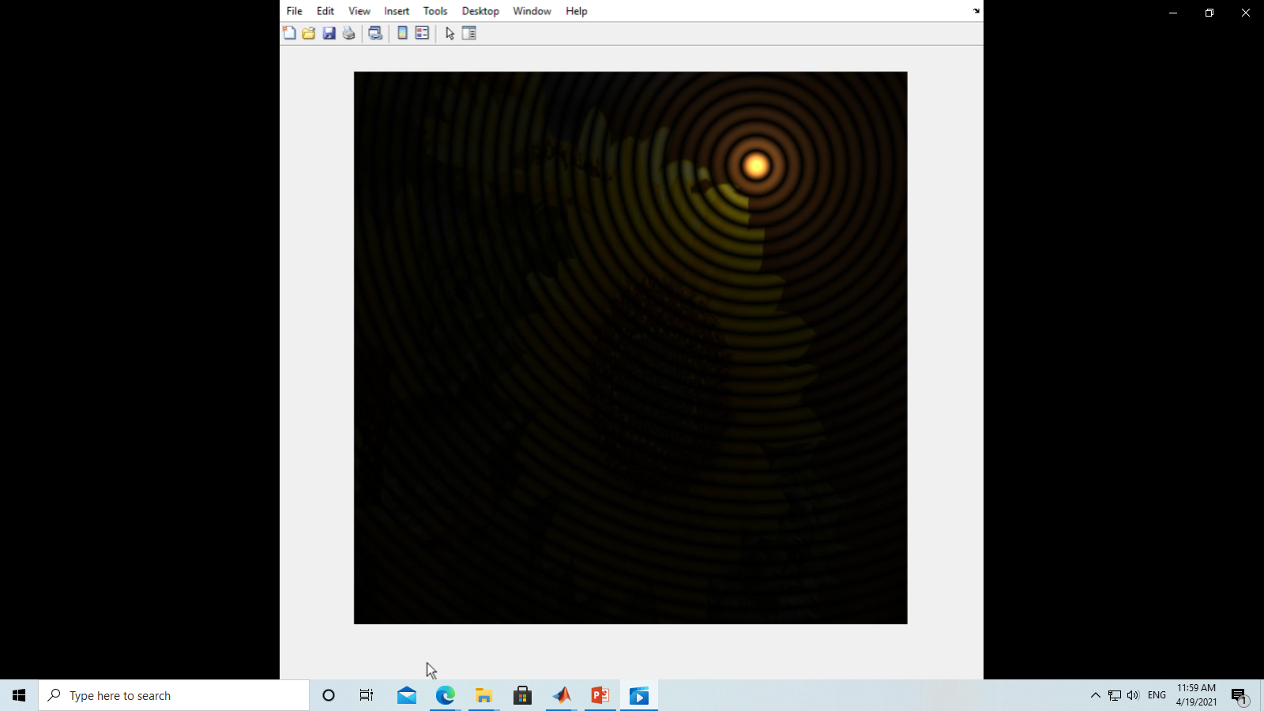
Problem 2.4. Marking Scheme
[1%] The image is the sun flower.
[4%] The intensity of the entire image is changing from dark to bright at the beginning.
[6%] The intensity of the rings are changing periodically.
[6%] The rings rotates around the center of the image in clockwise direction.
[6%] More and more rings are created during the process. At least 10 rings at the end.
[2%] The performance must be interactive.

Slide 23
End
Enjoy MATLAB Programming.

